Slide 1

Dementia
Research and interview summary
How to help people with this untreatable condition?

Slide 2
Research summary
Documentary and Paper Research
Summary Talk

Slide 3

Interview summary
What can someone with the condition tell us?
Summary Talk

Slide 4

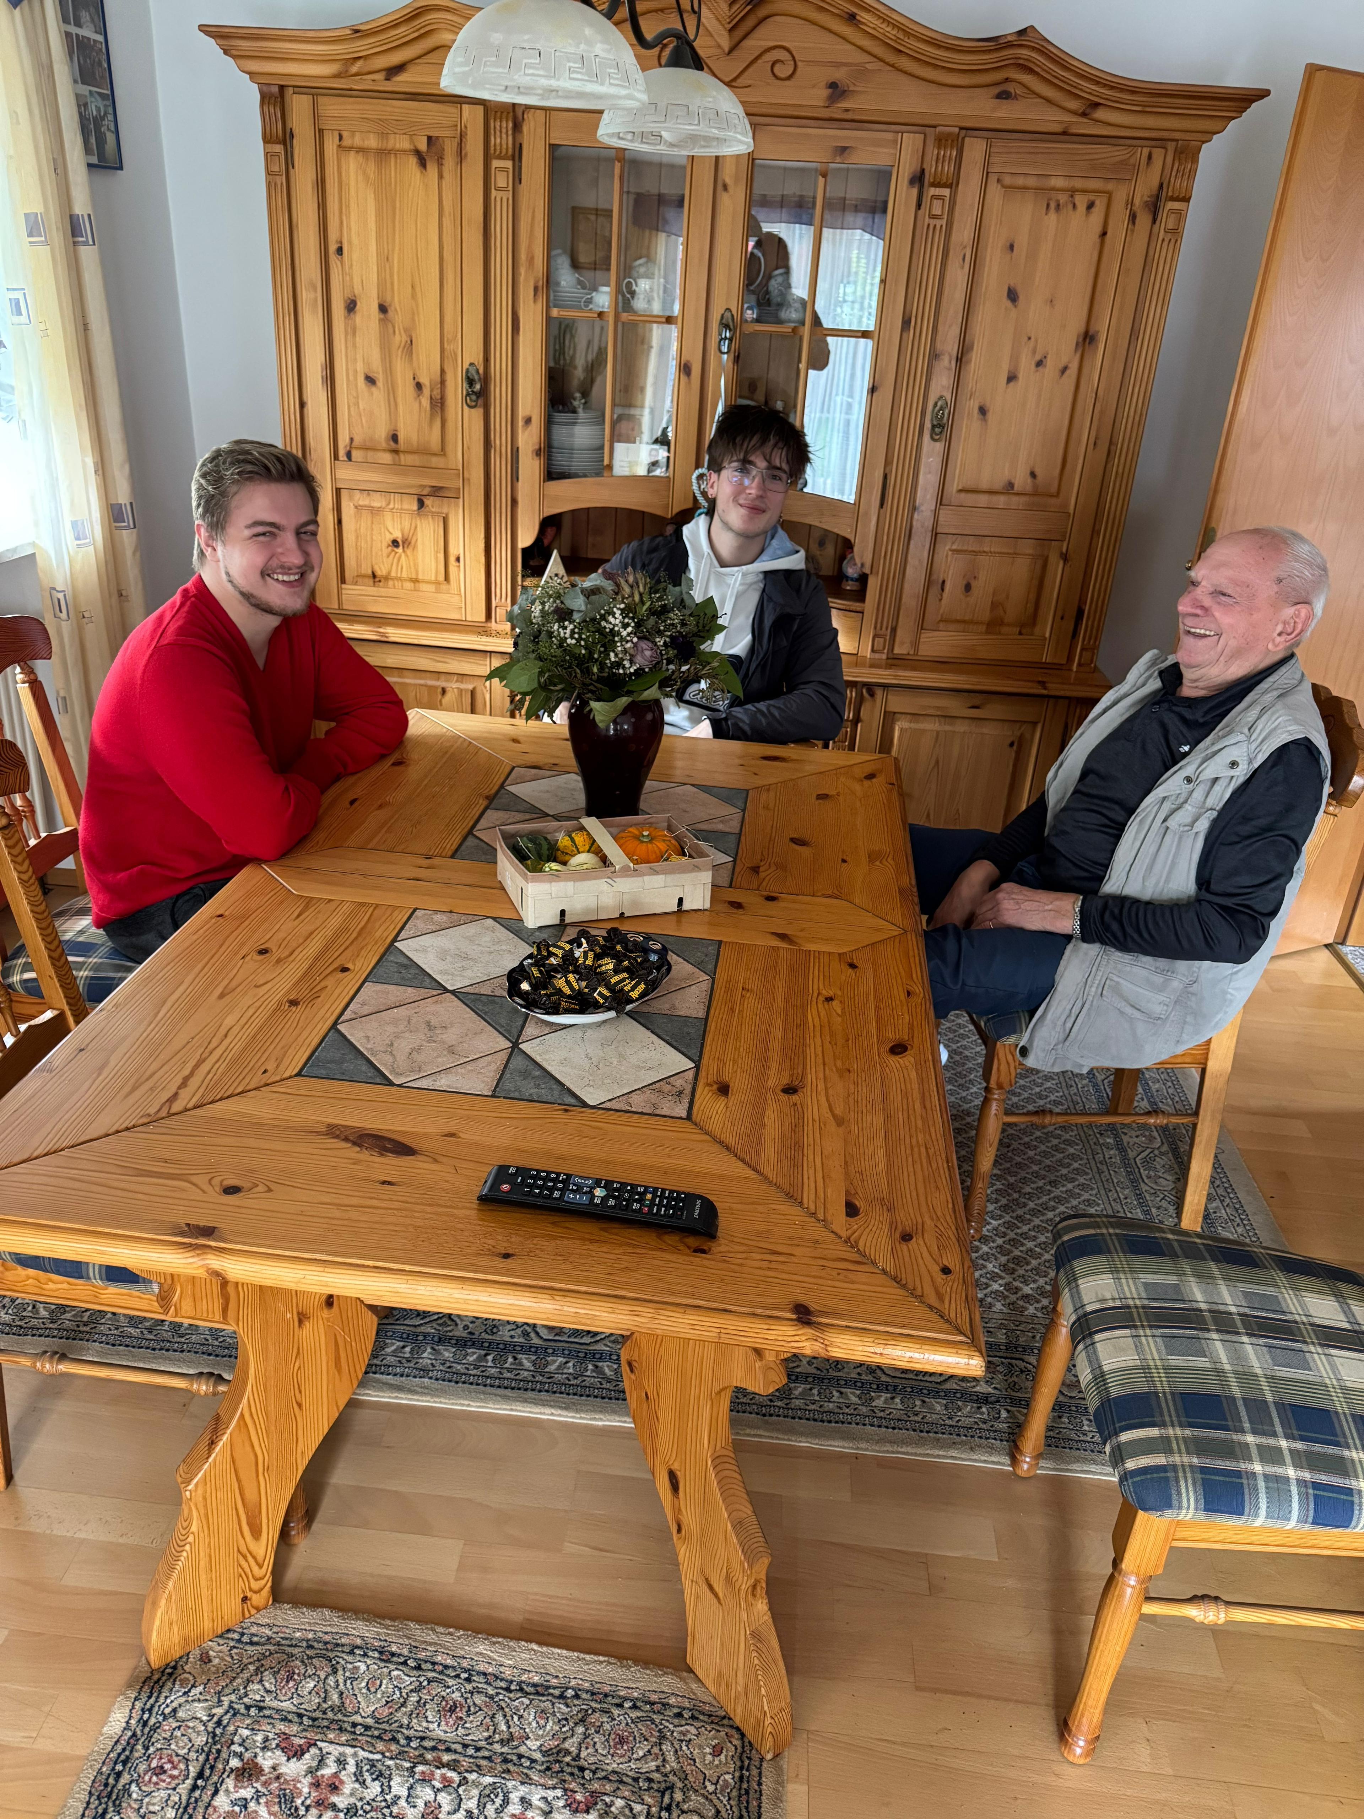
The Interview
We were lucky to be able to talk with Sepp (Josef)
He is suffering from Dementia for about 2 years
Summary Talk

Slide 5
What Problem do we address?
Handling the situation for the patient and the family providing them with a system for it
Especially in regard for safety and stress relief
Summary Talk

Slide 6
THANK YOU
WOODGROVE BANK
Sources:
Enhancing prompt perception in dementia: a comparative study of mixed reality cue modalities
Multiple published Documentaries for example from BBC

